Slide 1
Locally Optimized Feature Weighted Ball Tree kNN - LOFWBT-kNN
Dylan Tallis and Anna Wisniewski

Slide 2
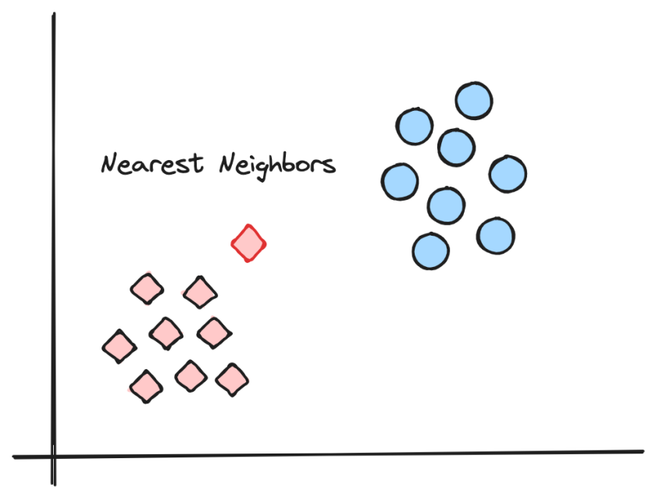
Intro - kNN Algorithm
Calculate distance from instance to all points
Pick k closest and simple majority vote for predicted class

Slide 3
Related Work
James Keller: FKNN
Distance weighing
Kumbure and Luukka: FWM-LMFKNN
Feature weighting (MI)
Minkowski distance
Local means
Vahedifar et al.: IMKNN
MI
Shapley values
Pan et al.: DC-LAKNN
Locally adaptive k
Rajani et al.:
Ball Trees

Slide 4
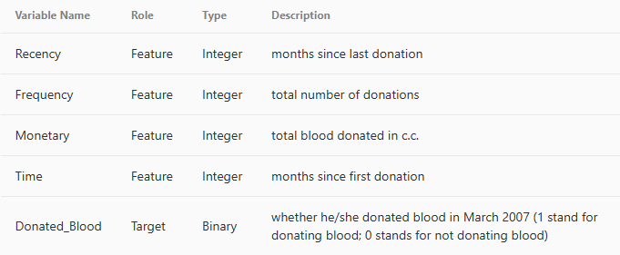
Blood Donor Dataset
748 instances, 4 features, predicting future blood donation
UCI ML Dataset
Used as a benchmark by several other papers
Numeric data

Slide 5
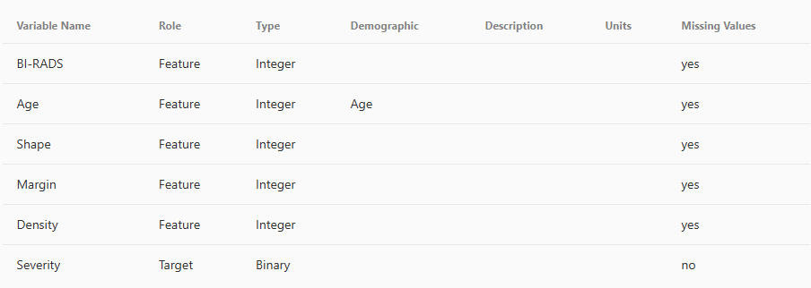
Mammogram Dataset
961 instances, 6 features, class benign/malignant
UCI ML dataset
Mostly categorical (integer encoded)
Missing values

Slide 6
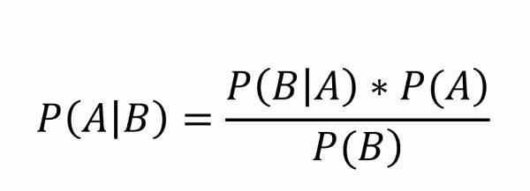
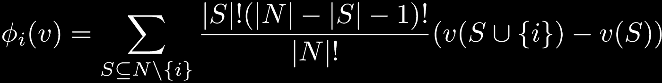
Shapley Values
Naive Bayes trained on dataset, Shapley values used to find feature contribution to classification
Evaluates how much presence of feature improves accuracy compared to absent

Slide 7


Mutual Information
Compares probability distribution of feature to joint of feature and class
Compares probability of occuring together to expected if independent

Slide 8
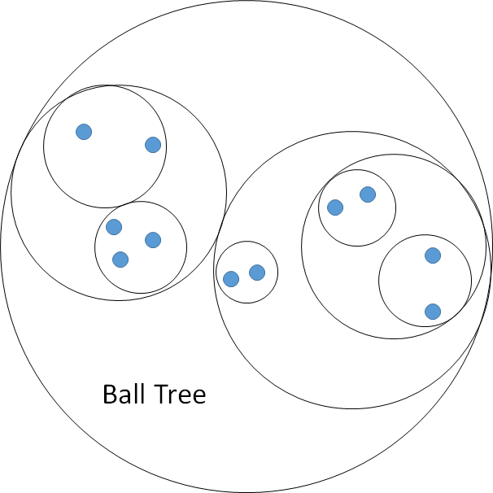
Ball Tree
Partitions dataset to make searches more efficient
O(logN) vs O(N)
Splits recursively starting at pivot point
Separates points within median distance from pivot and those outside

Slide 9
Local k Selection
Based on consistency of classes in neighborhood
Picks smallest k with high consistency

Slide 10
Results - Accuracies
 | LOFWB-KNN | KNN | FWM-LMFKNN | FKNN
Mammogram | 80.83 | 79.79 | 77.31 | 77.2
Blood | 78.67 | 77.65 | 74.67 | 73.33

Slide 11
Results
Mammogram
Blood
Model | Precision | Recall
LOFWB-KNN | 0.833 | 0.773
KNN | 0.830 | 0.753
FKNN | 0.791 | 0.742
Model | Precision | Recall
LOFWB-KNN | 0.467 | 0.226
KNN | 0.348 | 0.258
FKNN | 0.320 | 0.258

Slide 12

Discussions
Localized Naive Bayes
Higher dimensional data
Different weighting strategies
Unbalanced data

Slide 13
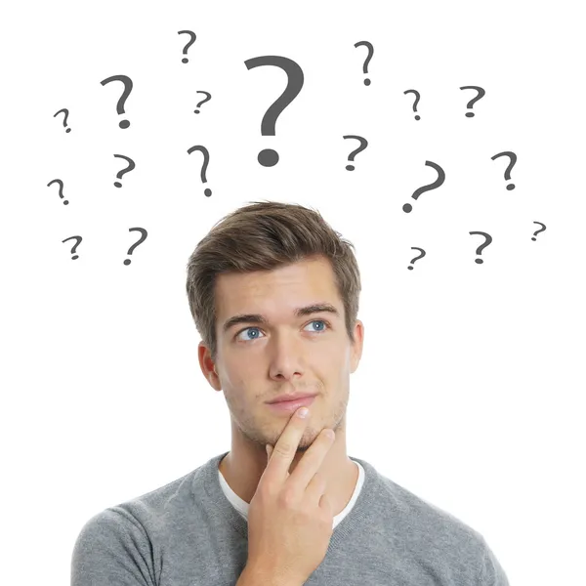

Thanks! Any Questions?

